Slide 1
Load Testing Tools
Lecturer: Ngo Huy Bien
Software Engineering Department
Faculty of Information Technology
VNUHCM - University of Science
Ho Chi Minh City, Vietnam
nhbien@fit.hcmus.edu.vn

Slide 2

Objectives

Slide 3

Contents
JMeter
Locust
k6

Slide 4

References

Slide 5
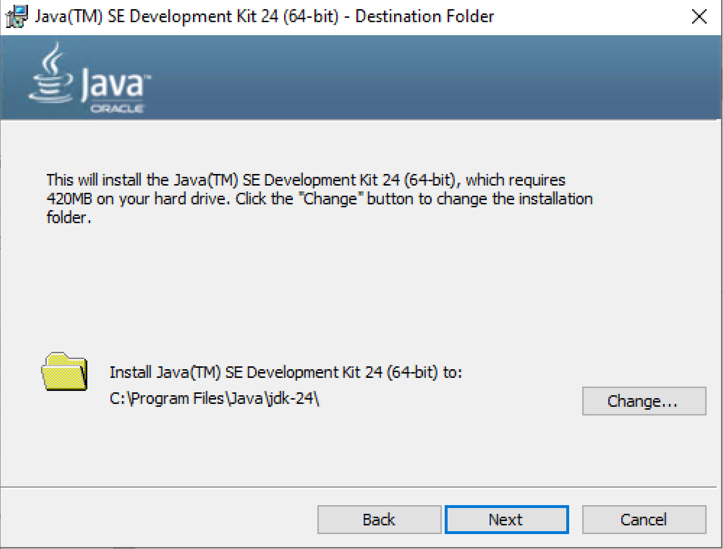
1. Install JDK 24 on Windows
https://www.oracle.com/java/technologies/downloads/

Slide 6
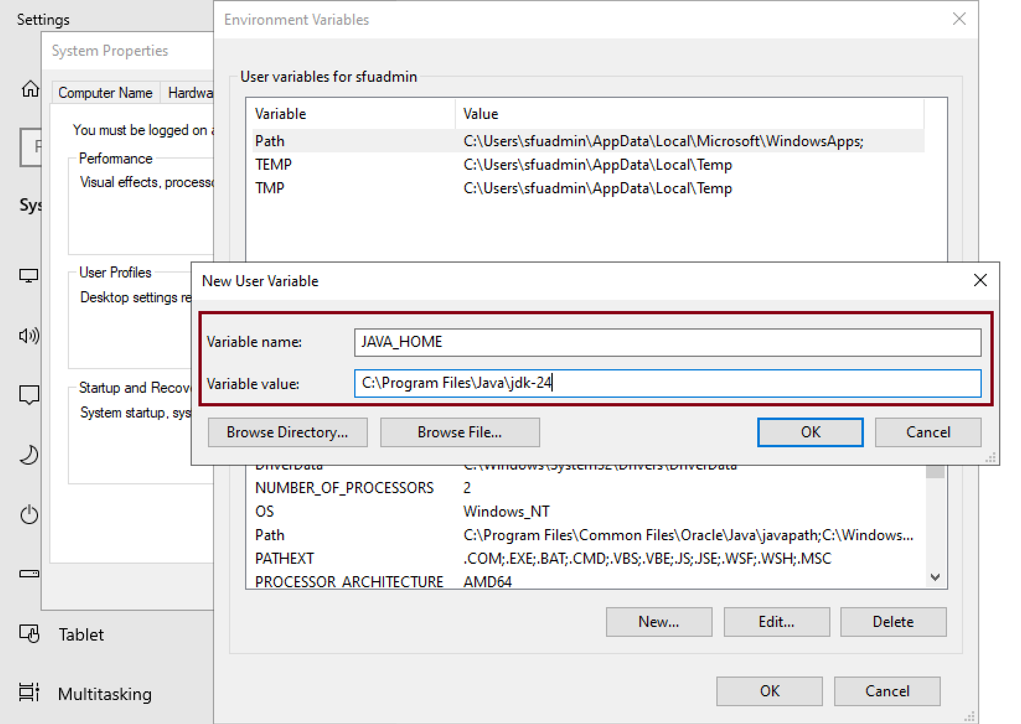
2. Add JAVA_HOME Variable

Slide 7
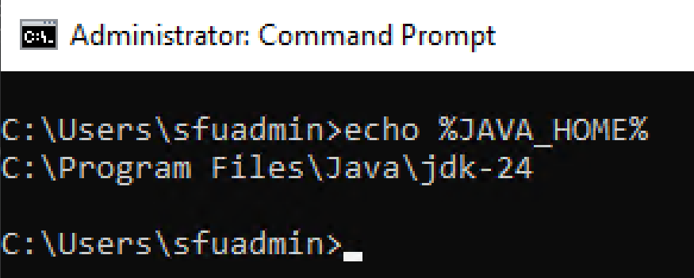
3. Verify JAVA_HOME Variable
echo %JAVA_HOME%

Slide 8
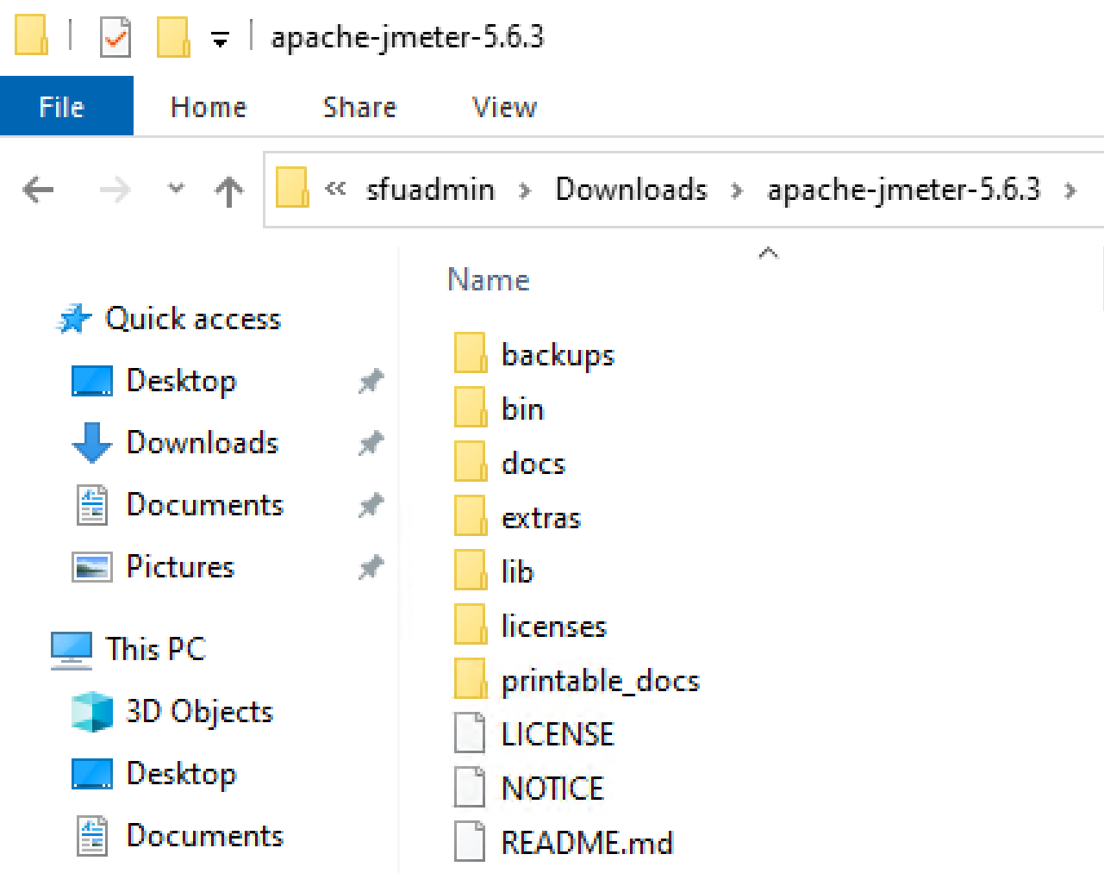
4. Download and Unzip JMeter
https://jmeter.apache.org/download_jmeter.cgi

Slide 9
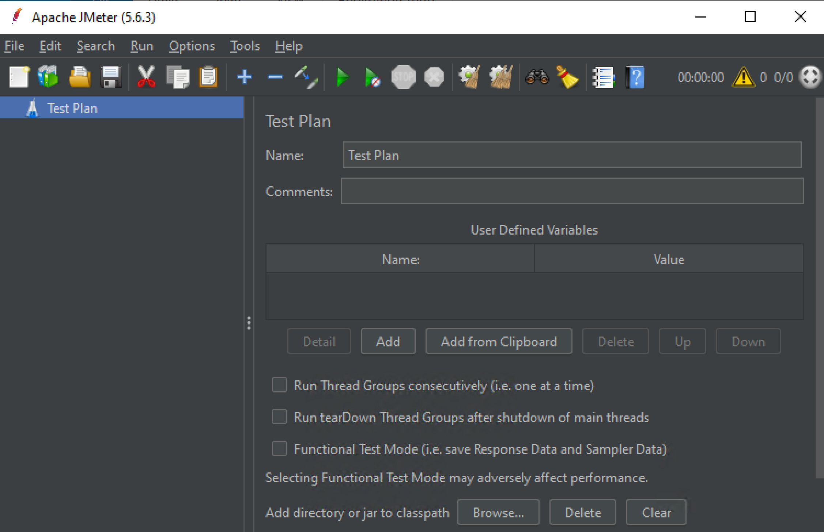
5. Run Jmeter (jmeter.bat)

Slide 10


Slide 11
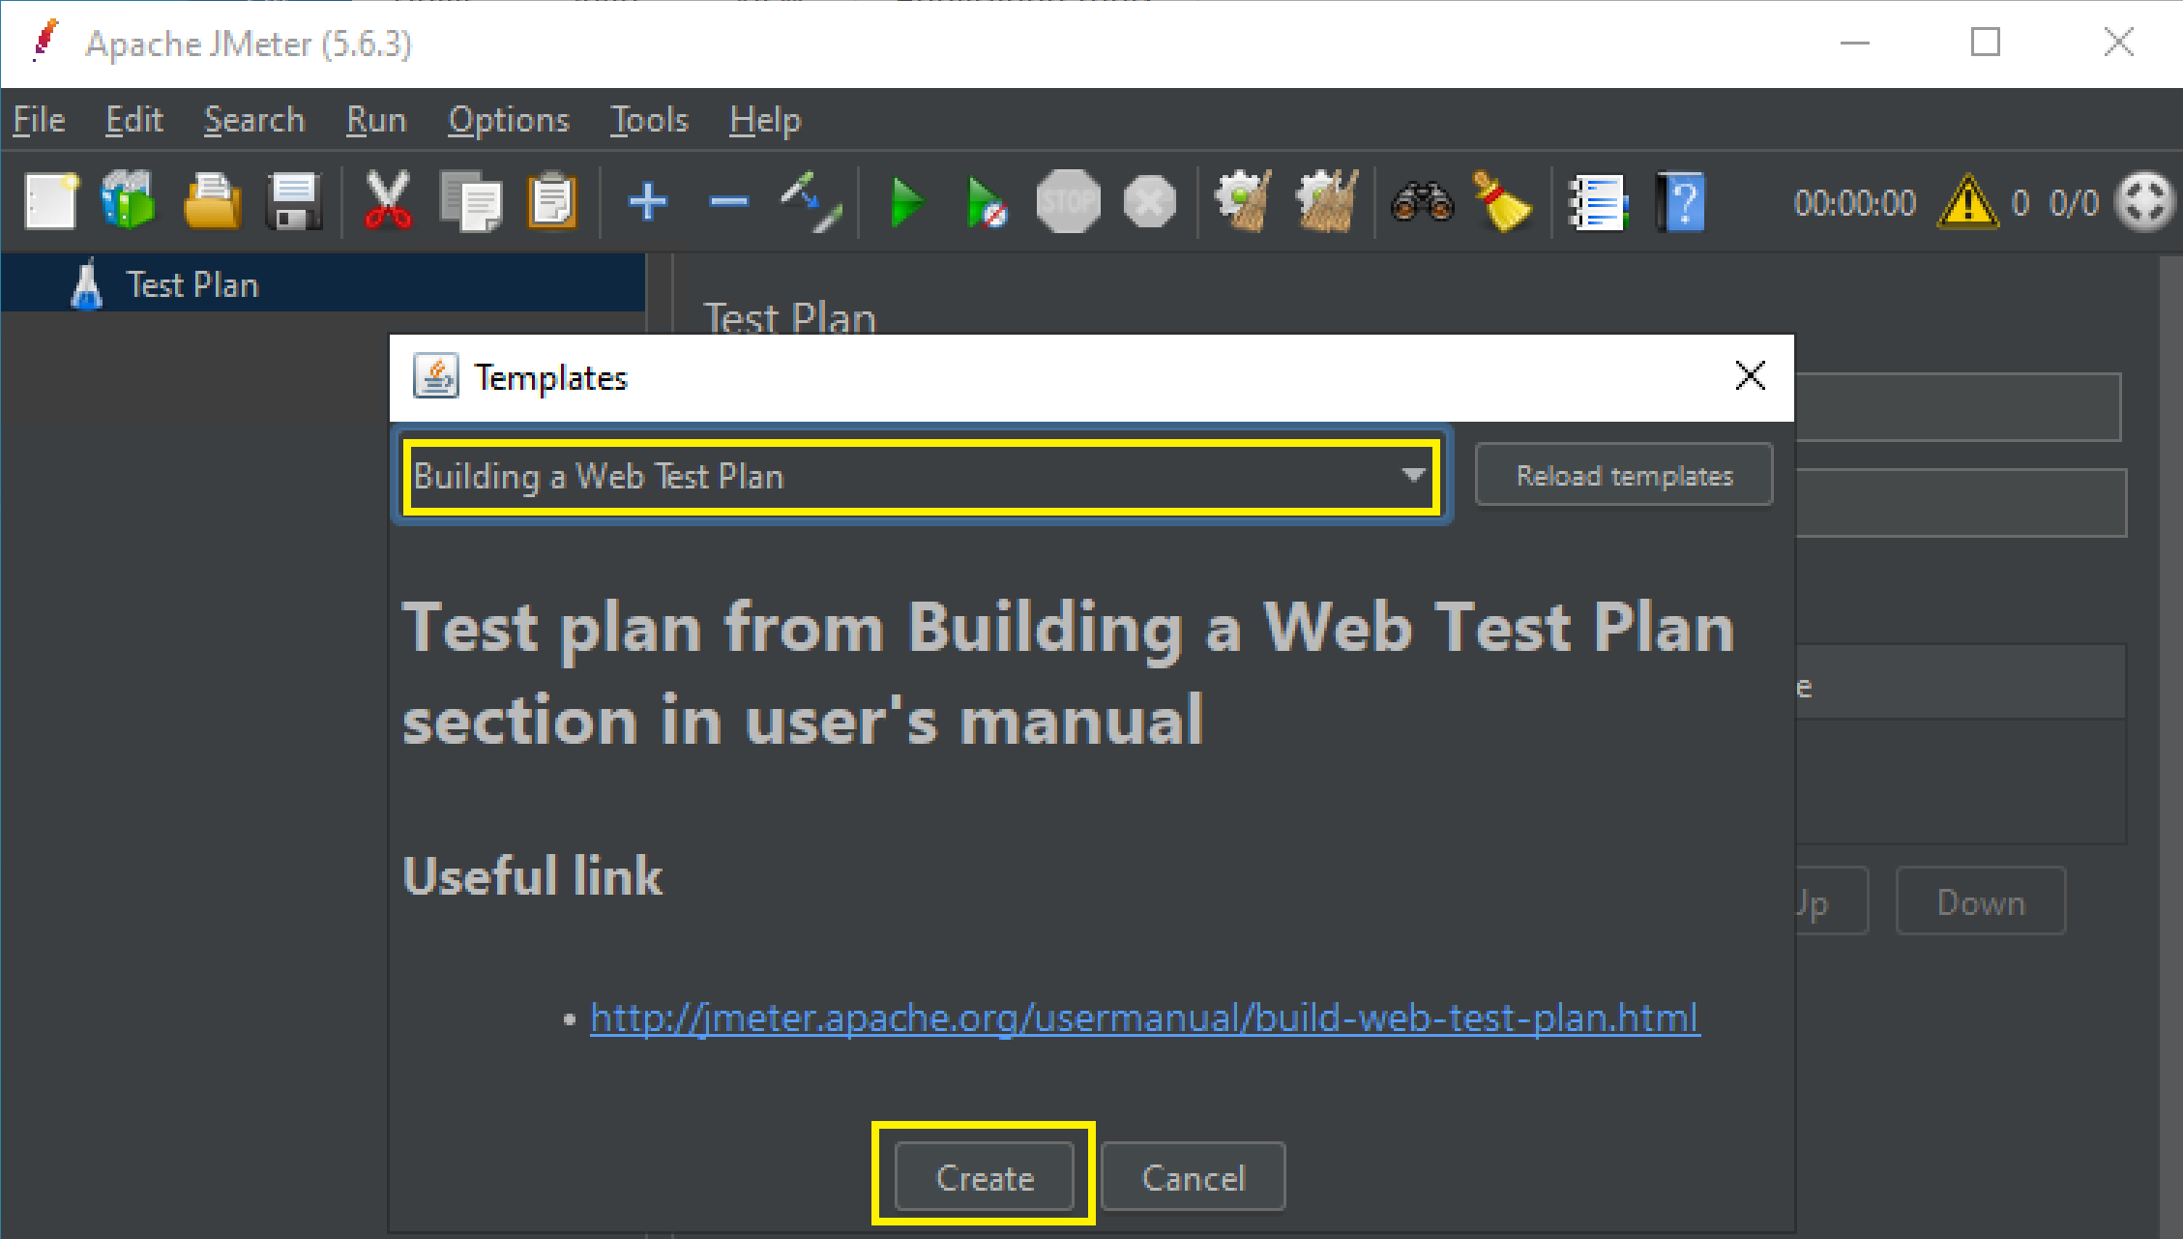
1. Create a Web Test Plan
https://jmeter.apache.org/usermanual/build-web-test-plan.html
File > Templates.

Slide 12
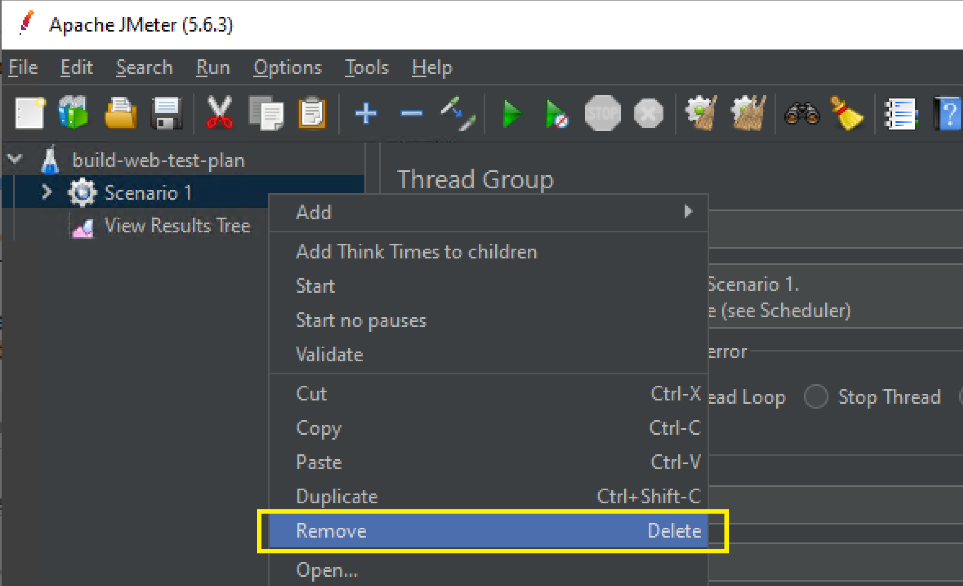
2. Remove Scenario 1

Slide 13
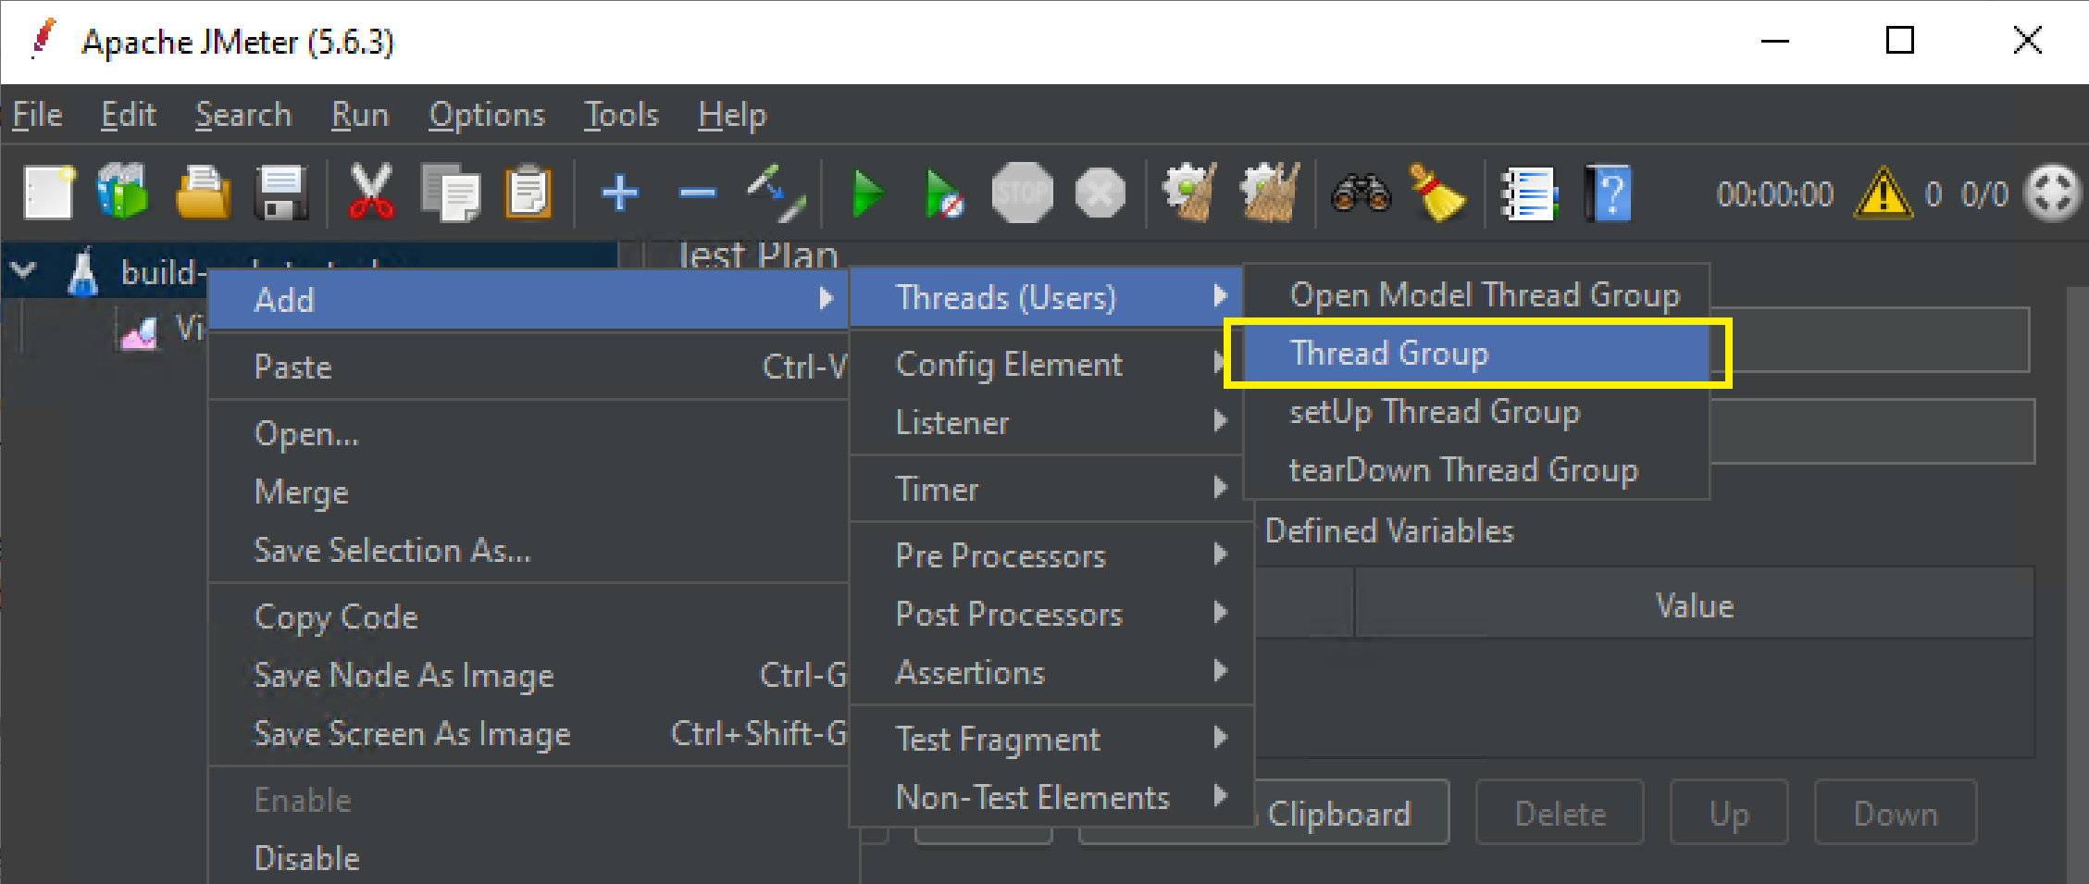
3. Add Thread Group

Slide 14
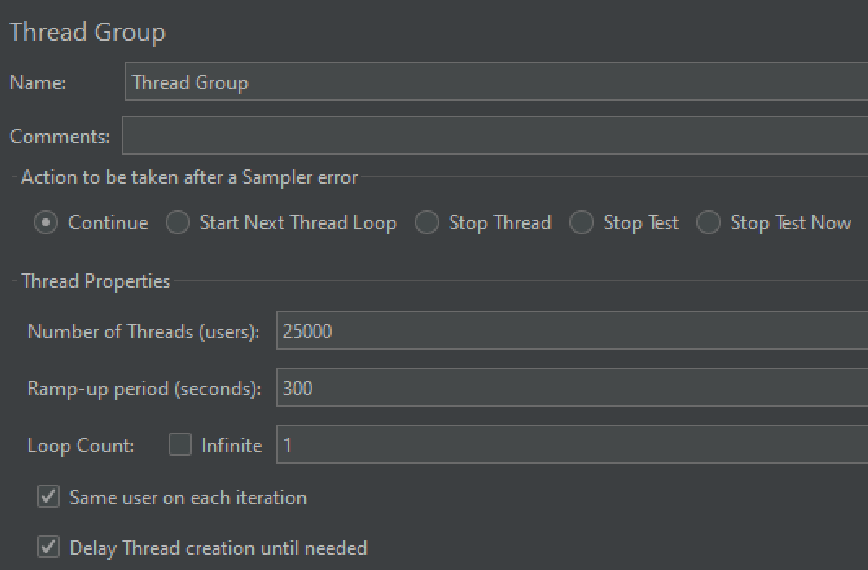
4. Configure Thread Group
Number of threads (users): 100
Ramp-up period: 10 seconds
In this case, JMeter will add 10 users per second for 10 seconds until all 100 users are active.

Slide 15
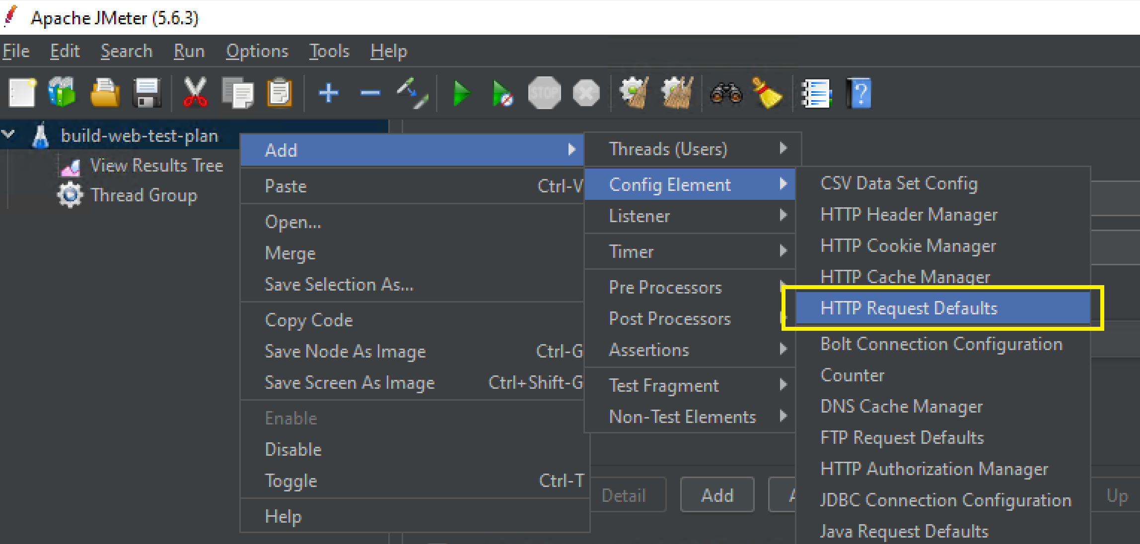
5. Add HTTP Request Defaults
To configure default values for all requests.

Slide 16
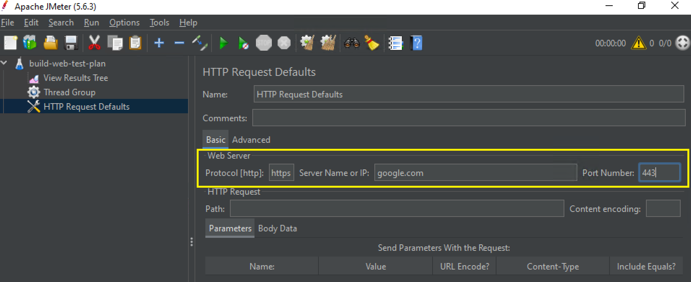
6. Configure HTTP Request Defaults

Slide 17
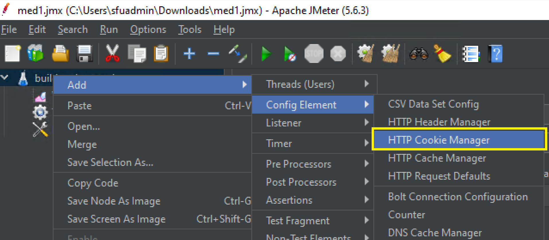
7. Add HTTP Cookie Manager

Slide 18
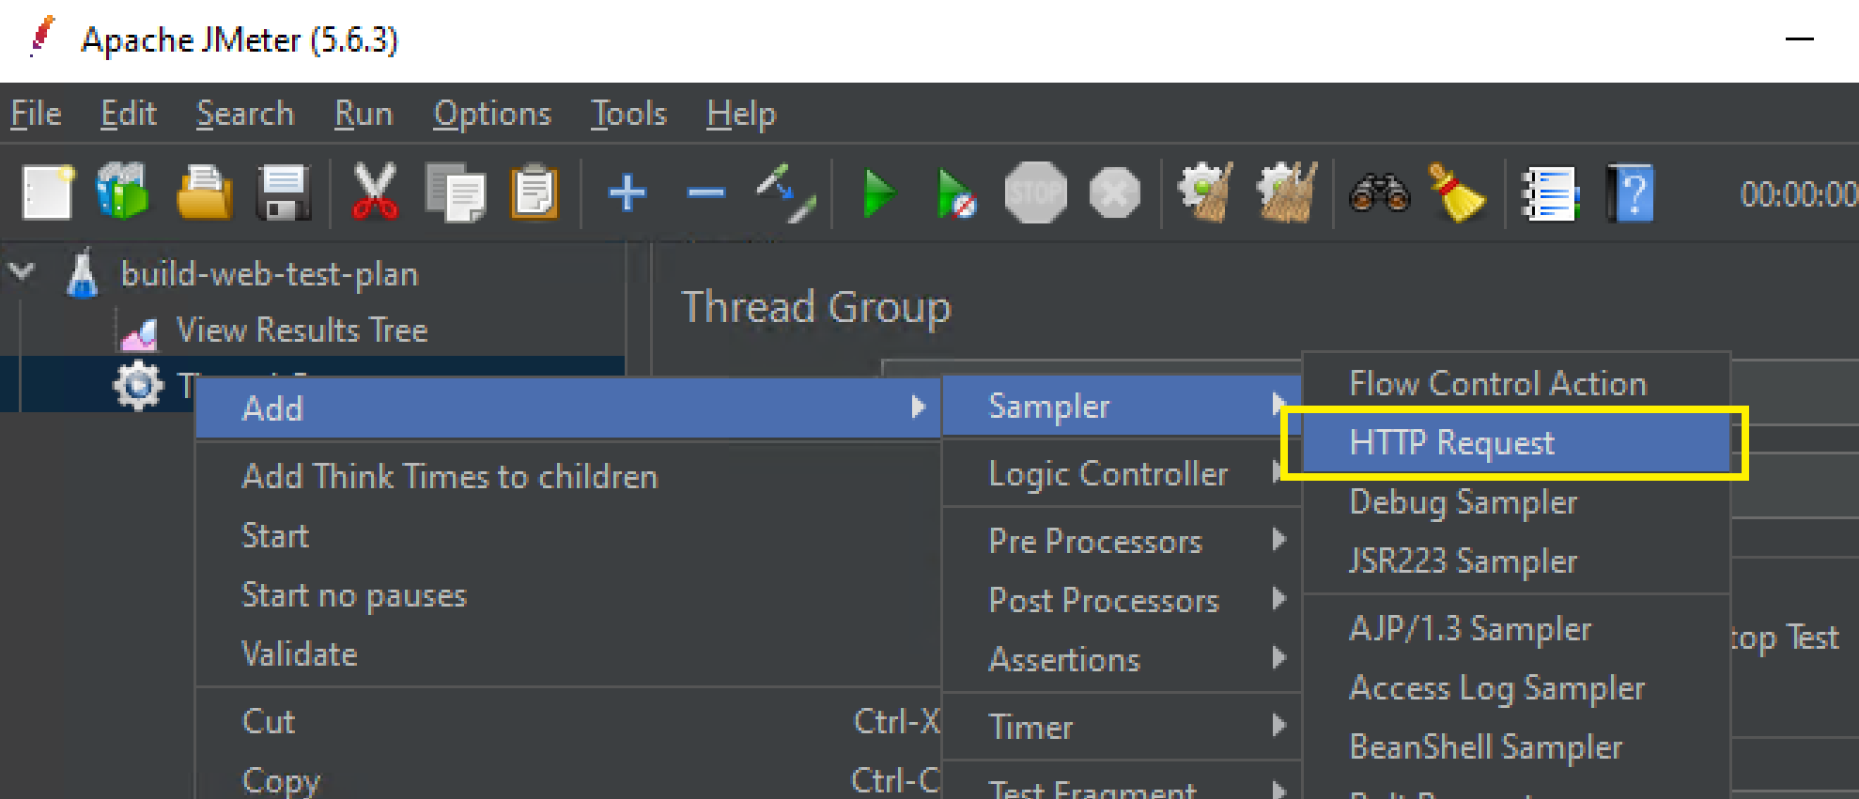
7. Add HTTP Request Sample

Slide 19
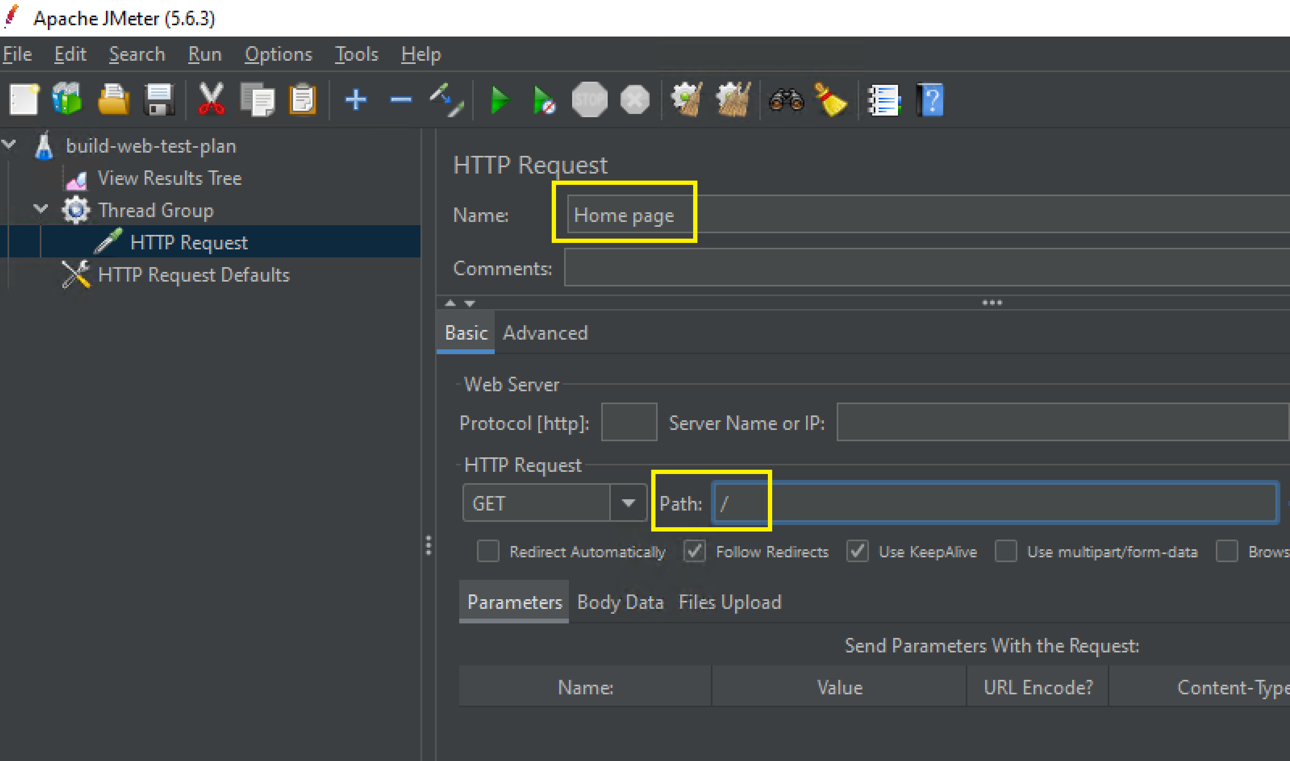
8. Configure the HTTP Request

Slide 20
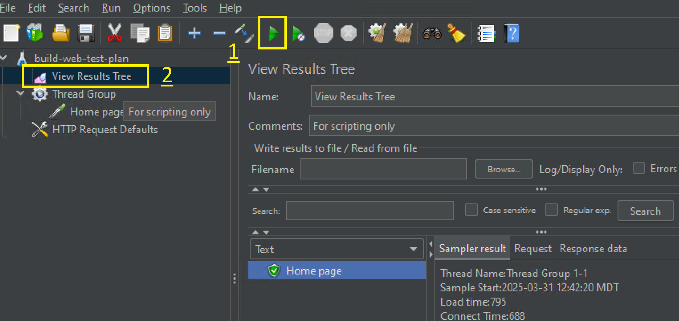
9. Run the Test and View Results

Slide 22
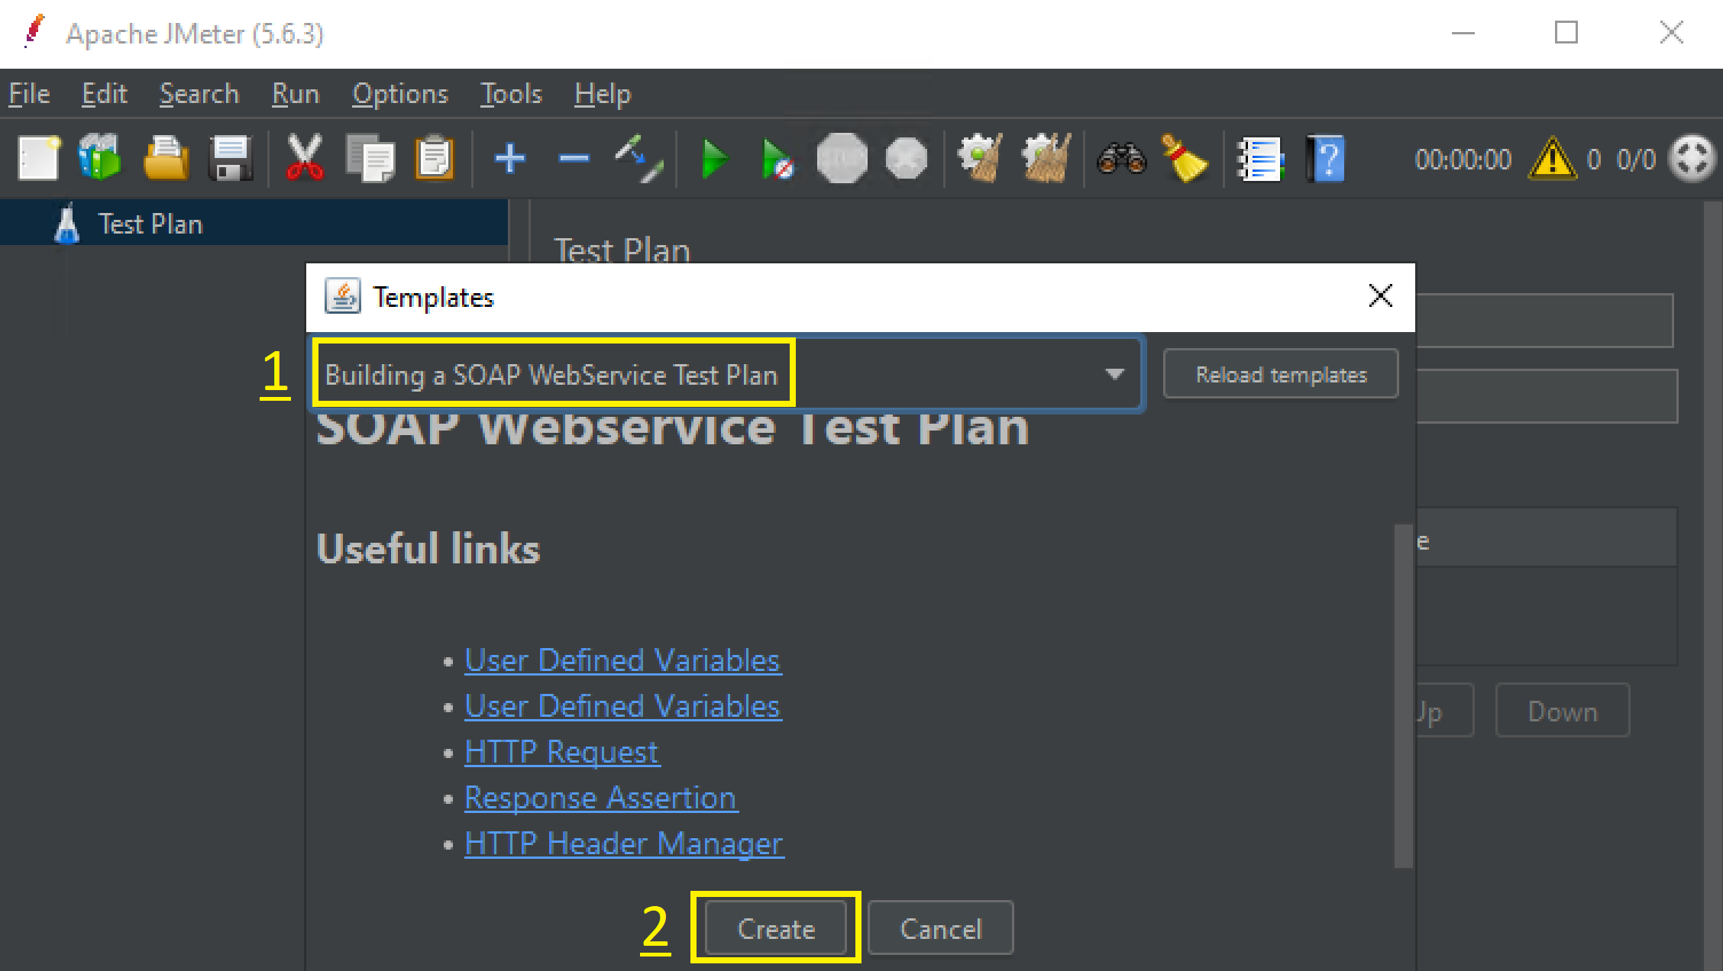
1. Create a WebService Test Plan
https://jmeter.apache.org/usermanual/build-ws-test-plan.html
File > Templates.

Slide 23
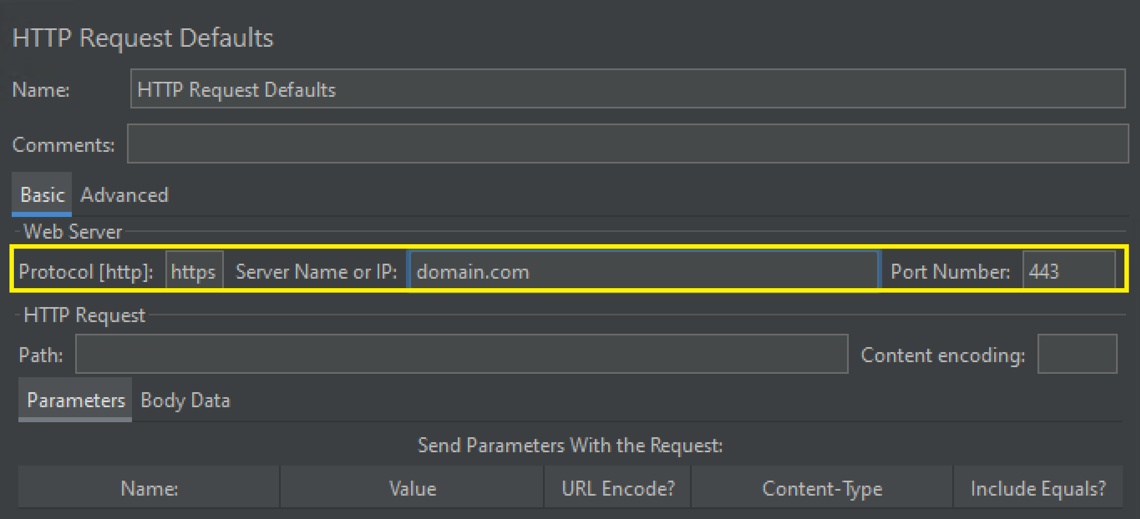
2. Enter Server Name or IP

Slide 24
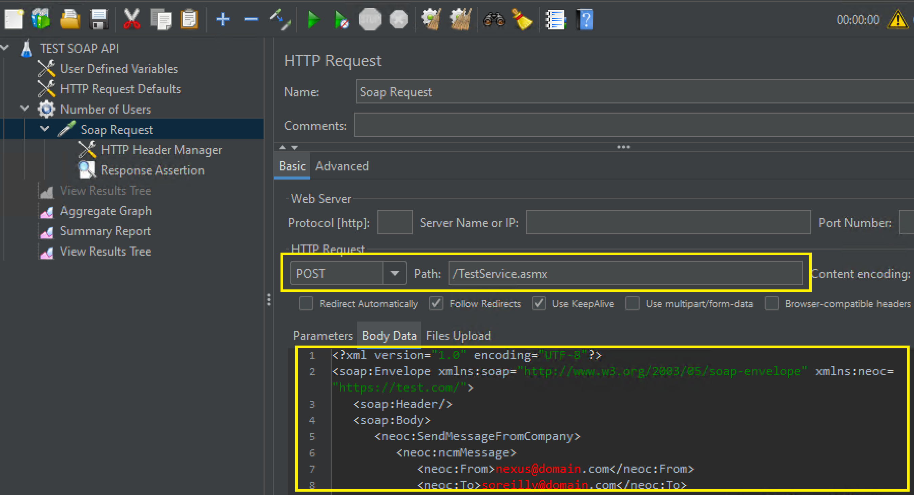
3. Enter Soap Request Information
Use SOAPUI to Generate SOAP Message from WSDL. This is important because an incompatible SOAP request may cause strange returns, not errors.

Slide 26
why should we run jmeter load testing in cli instead of gui mode?
Faster Execution: Running tests without UI overhead speeds up execution and result generation.
Lower Resource Consumption: The GUI consumes significant CPU and memory, which can interfere with test execution.
More Stable Execution: The GUI may introduce lags or inconsistencies due to UI rendering.
No UI Delays: CLI mode ensures that test execution is not impacted by graphical interface responsiveness.
Distributed Load Testing: CLI mode supports JMeter's distributed testing feature, allowing multiple machines to generate load.
Customizable Reports: CLI mode allows exporting results in various formats (CSV, XML, JSON) for deeper analysis.

Slide 27
1. Modify the HEAP environment variable in JMeter's batch file
For Windows (jmeter.bat):
Open the JMeter installation directory.
Locate and edit the jmeter.bat file using Notepad or any text editor.
Find the following line (usually near the top of the file): set HEAP=-Xms1g -Xmx1g -XX:MaxMetaspaceSize=256m
Modify it as needed. For example, if you want to increase heap size: set HEAP=-Xms4g -Xmx6g -XX:MaxMetaspaceSize=1024m
Save the file and restart JMeter.

Slide 28
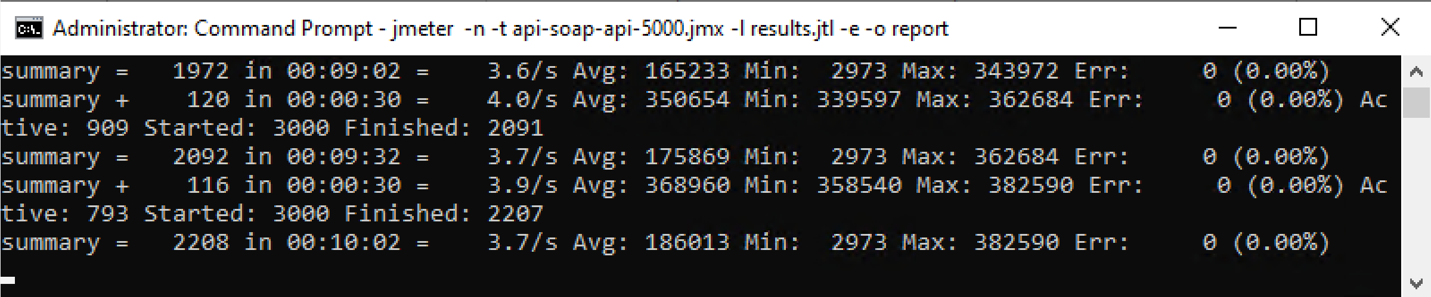
2. Run JMeter in CLI Mode
cd C:\Users\sfuadmin\Downloads\apache-jmeter-5.6.3\bin
mkdir report
del results.jtl
jmeter -n -t api-soap-api-5000.jmx -l results.jtl -e -o report
# Maximaze the cmd windows if it seems not to respond.

Slide 30
JMeter vs. Locust: Performance and Resource Usage
https://locust.io/
JMeter uses a multi-threaded model where each virtual user (VU) is represented by a separate thread. Due to its thread-based architecture, JMeter can consume significant system resources (especially memory and CPU) when simulating a large number of users.
Locust uses an event-driven approach. It is based on gevent, which allows asynchronous tasks to run concurrently without blocking. This makes Locust more efficient in simulating a large number of virtual users with fewer resources.

Slide 31
JMeter vs. Locust: Supported Protocols
JMeter supports a wide range of protocols out of the box, including HTTP, HTTPS, FTP, JMS, JDBC, SOAP, REST, SMTP, POP3, IMAP.
Locust is mainly designed for HTTP-based load testing (REST APIs, web apps), though custom code can be added to support other protocols.

Slide 32
JMeter vs. Locust: Reporting and Analytics
JMeter provides comprehensive built-in reporting, including graphs, tables, and other visual components. It also supports generating HTML reports after a test run, which provides detailed performance data. You can export results to CSV, XML, and JTL files for further analysis.
Locust provides real-time statistics during the test run through its web interface (requests per second, response times, failure rates, etc.). After the test, results can be exported to CSV for further analysis, but it does not have as many built-in reporting features as JMeter.

Slide 34
1. Install k6 on macOS
https://grafana.com/pricing/?src=k6io#k6-performance-testing
brew install k6
# Go to https://grafana.com > My Account to find a stack.
k6 cloud login --token 7e8f7f6 --stack valiantgranola1655

Slide 35
2. Create Script
Ask Claude Code to create one: 100 users, 10 minutes.
Min # of users =?, min duration = ?

Slide 36
3. Run the Script on the Cloud
k6 cloud run script.js

Slide 37
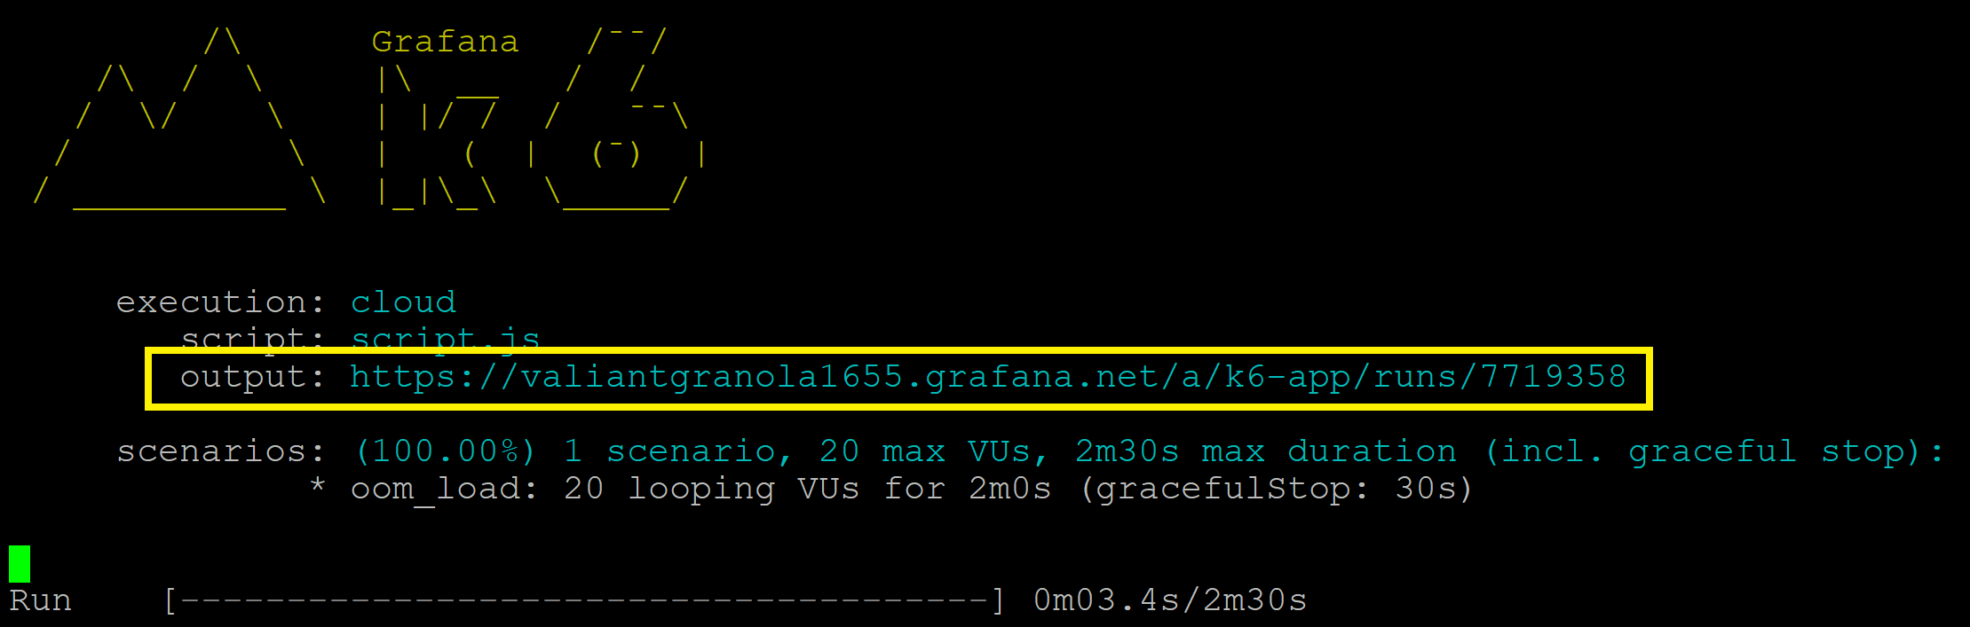
4. Review the Output
https://valiantgranola1655.grafana.net/a/k6-app/runs/7719358

Slide 38
5. Understand the OOM
When a process needs memory and the kernel has none left to give — no free RAM, nothing reclaimable, and no swap to page out to — the kernel can't just wait.
To avoid a total system freeze, it invokes the Out Of Memory (OOM) killer.
The OOM killer picks a process to terminate to free memory.
It scores every process (roughly by how much memory it's using, via oom_score) and kills the one that frees the most.
The kill is a hard SIGKILL (signal 9) — the process is terminated instantly, no clean shutdown.

Slide 39
6. Verify the OOM
Ask Claude Code to record baseline (pre-test):
OOM kills this boot: 0.
MySQL PID: 847, 0 restarts.
Memory: used 1679 MB / available 2229 MB
MySQL Resident Set Size (RSS): 746 MB
php8.4 total: 754 MB
The sampler logs every 3 s for ~20 min into /tmp/oom_watch.log.
Run a load test.

Slide 40
7. Run the Script Locally
k6 run script.js
k6 run --out 'web-dashboard=host=0.0.0.0&port=5665&export=report.html&open=true' script.js
# Open: http://192.168.1.45:5665

Slide 41
8. Check for Memory Leaks
Investigate the memory usage of each process during the load test.
If a memory leak were present, the Resident Set Size (RSS) would continue to increase as a worker processes additional requests.
Instead, each worker's RSS reaches a peak within the first 30–60 seconds and then remains essentially flat for the remainder of its lifetime.

Slide 42
9. Understand PHP-FPM
The process manager is a feature of PHP-FPM (FastCGI Process Manager), which is part of PHP itself.
PHP-FPM decides "I want to run 5 site workers" (pm/max_children). It uses ordinary OS calls (fork) to create them — but the policy (how many, when) is entirely PHP's.
systemd launches the FPM master as a service and, with our proposed MemoryMax=2000M, wraps all its workers in a cgroup — a kernel memory boundary.
The kernel doesn't know or care about "dynamic vs ondemand"; it just enforces "this group of processes can't exceed 2.0 GB."

Slide 43
10. Reallocate Resources
max_children = 4 for resource-intensive sites.
max_children = 1 for lightweight sites.

Slide 44

Thank You & See You Again

